Slide 1
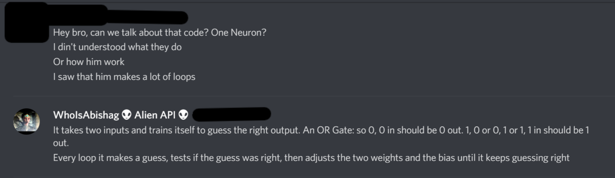
ONE Neuron Training
Some text here

Slide 2
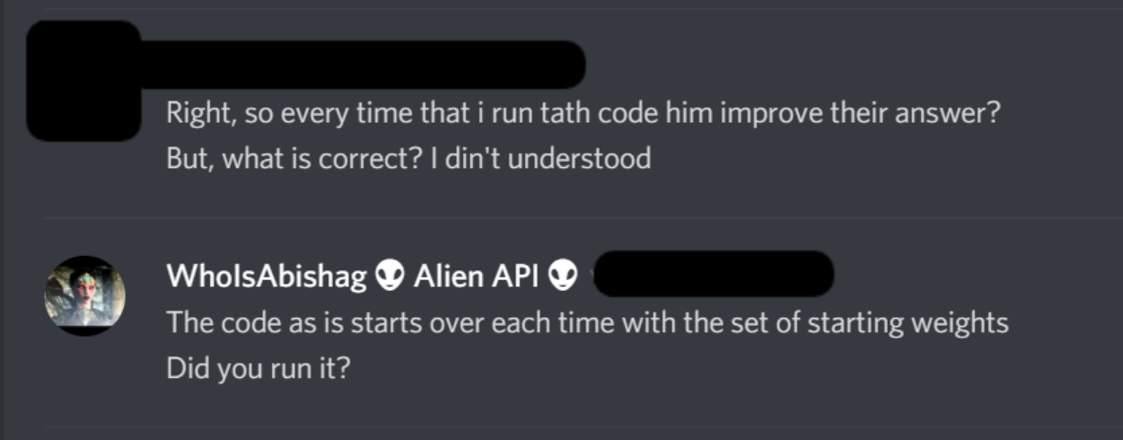
ONE Neuron Training
Some text here

Slide 3
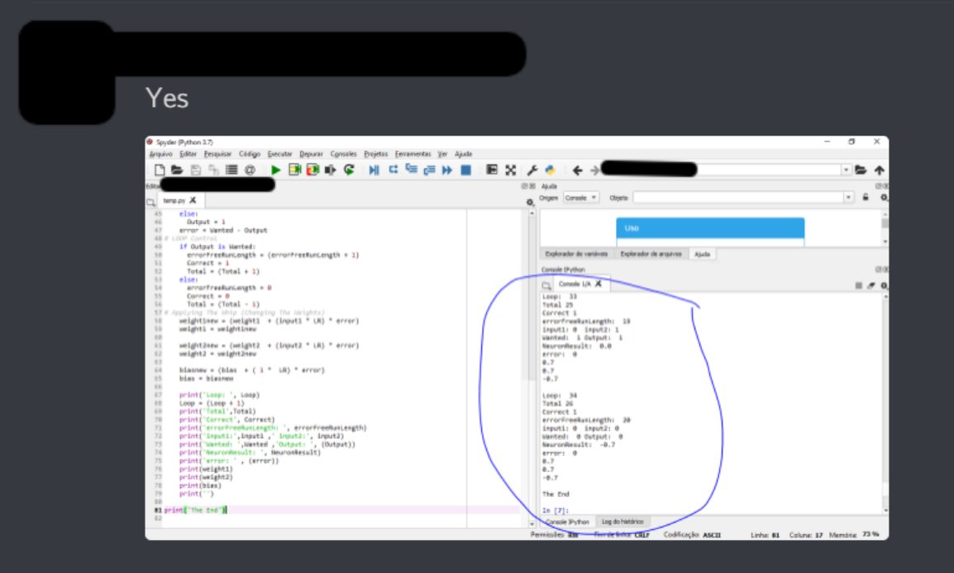
ONE Neuron Training
Some text here

Slide 4
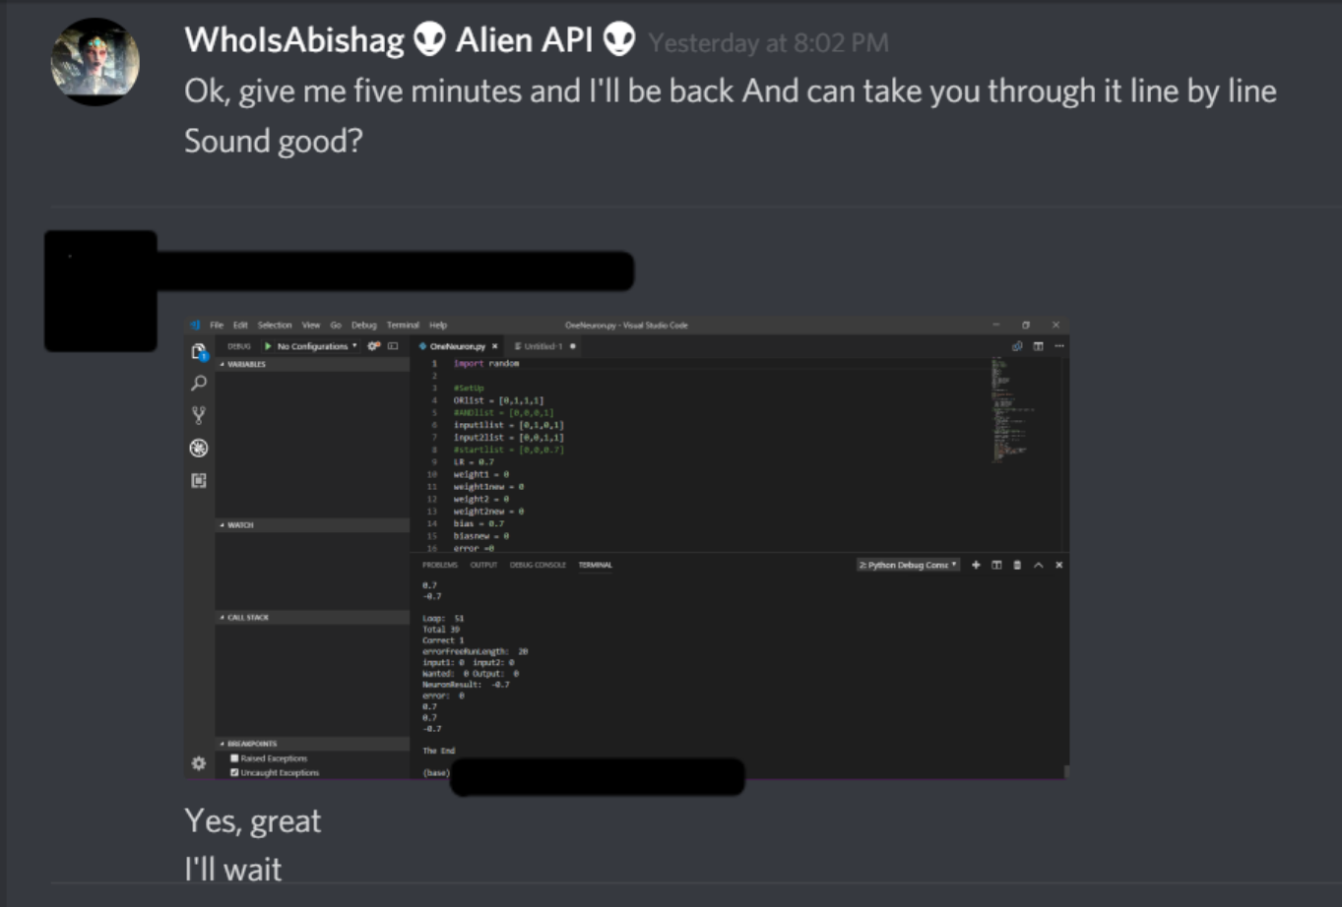
ONE Neuron Training
Some text here

Slide 5
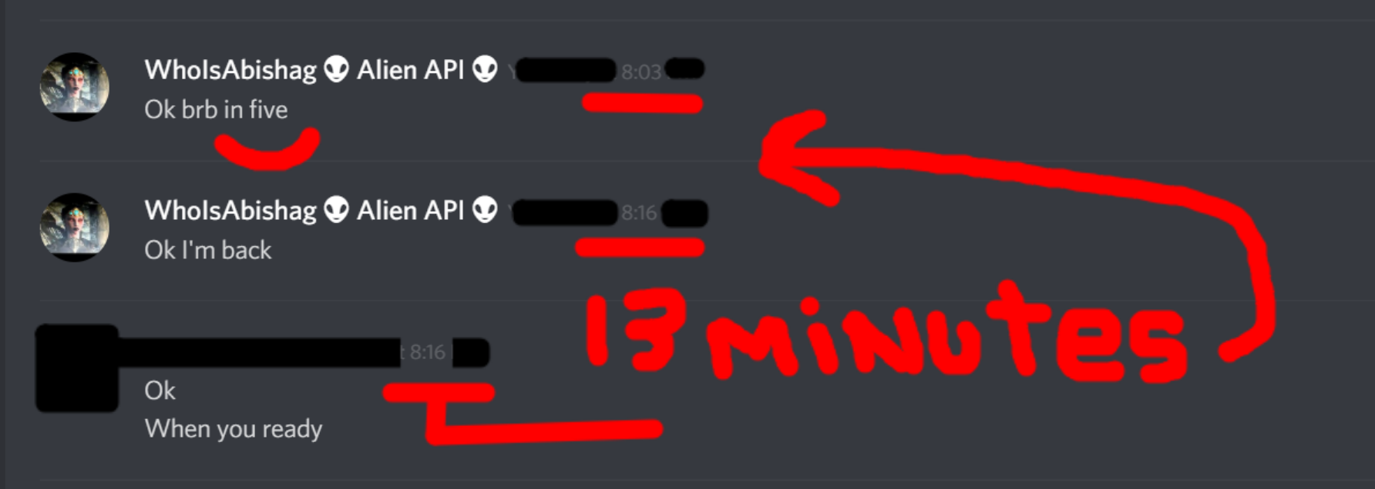
ONE Neuron Training
Some text here

Slide 6
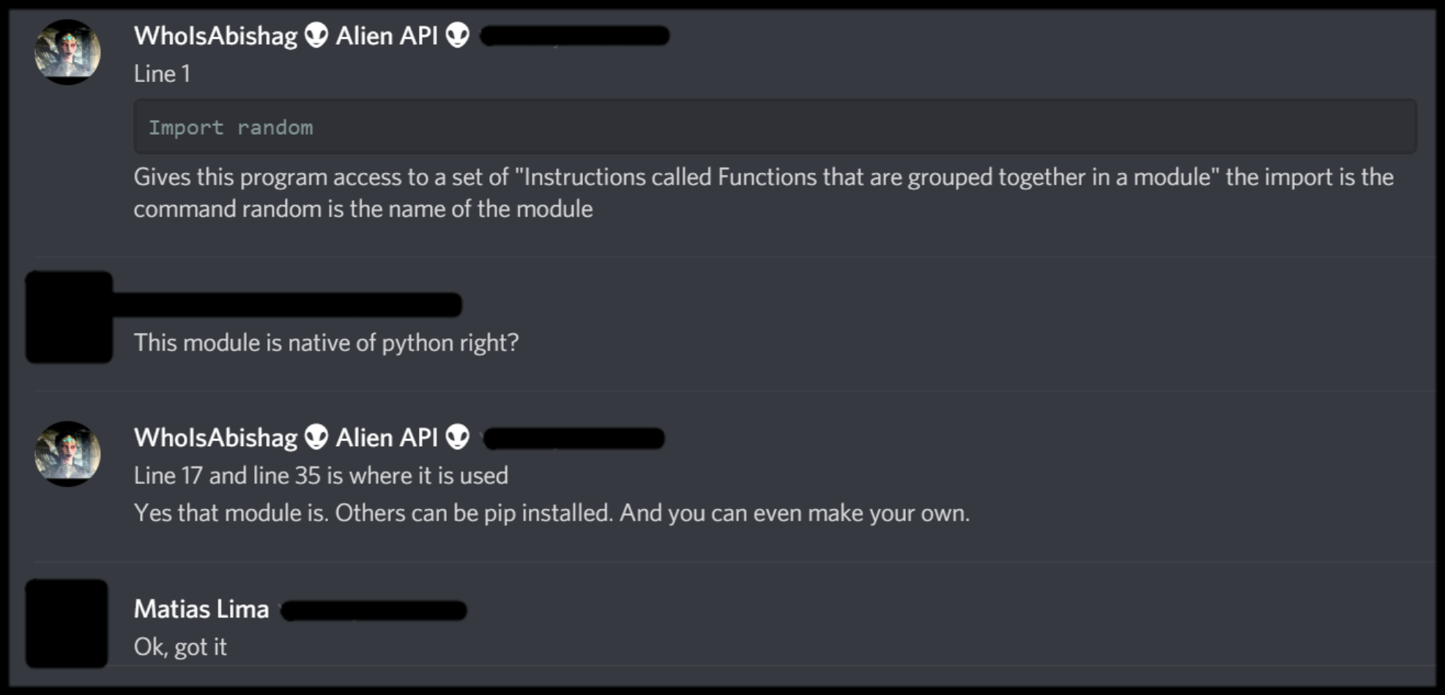
ONE Neuron Training
Some text here

Slide 7
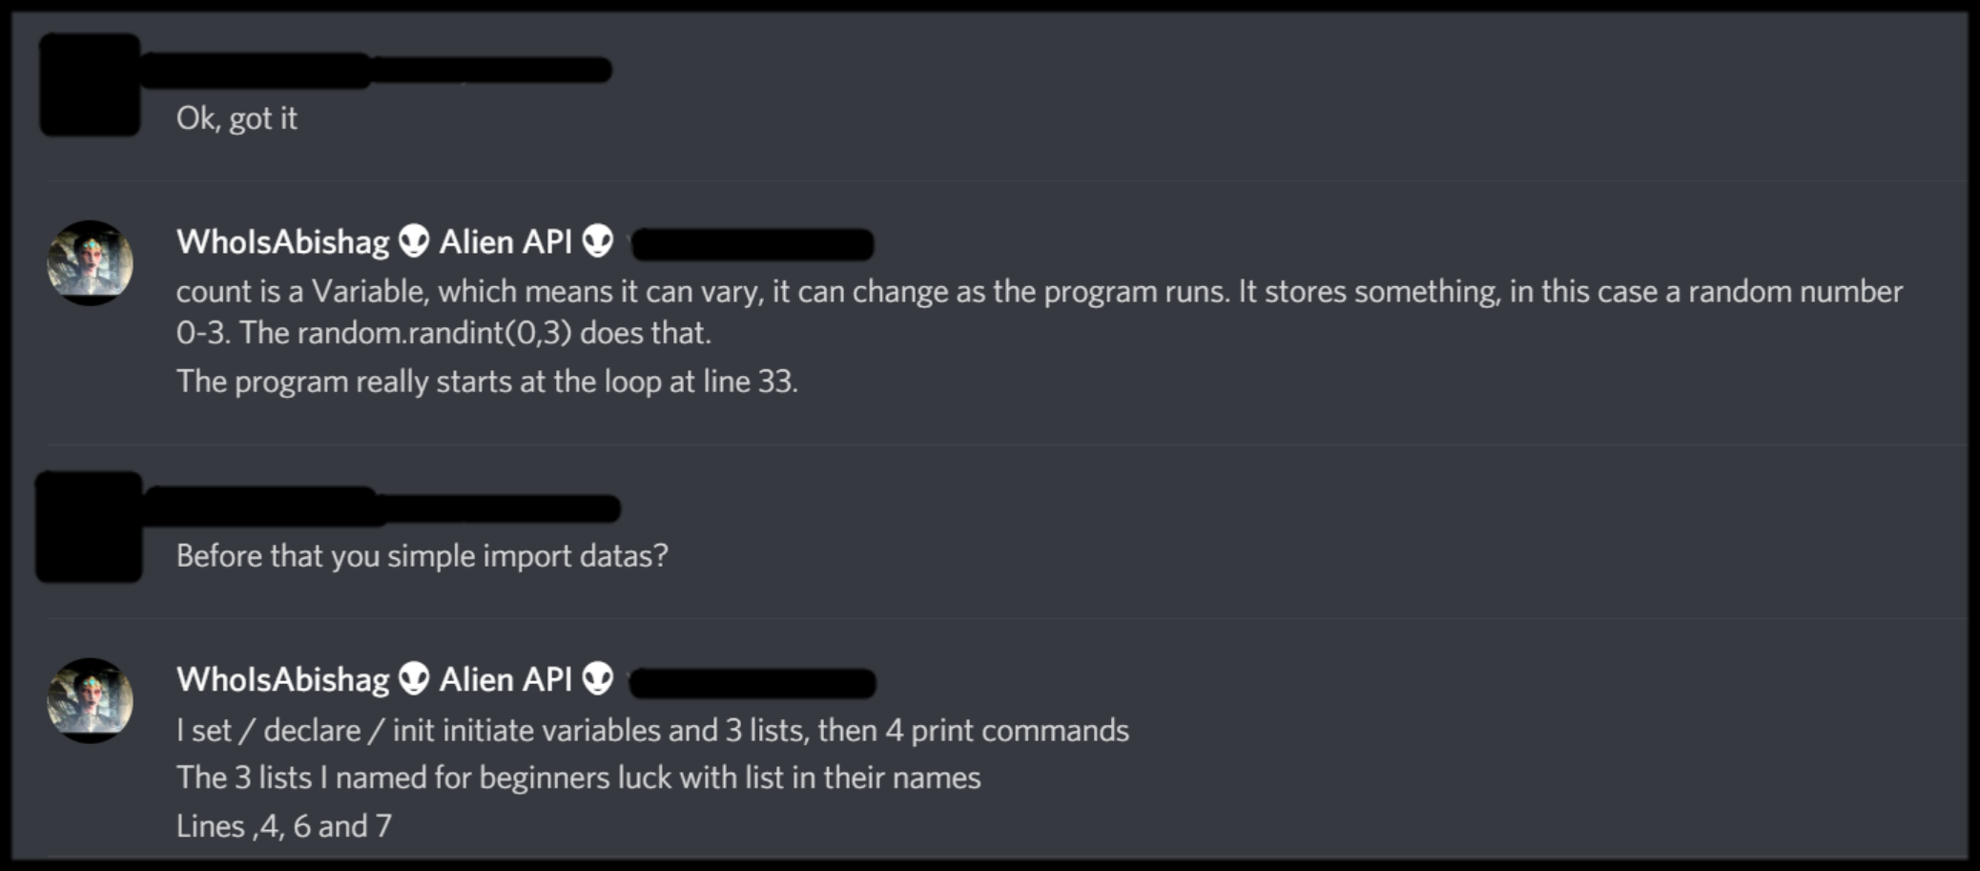
ONE Neuron Training
Some text here

Slide 8
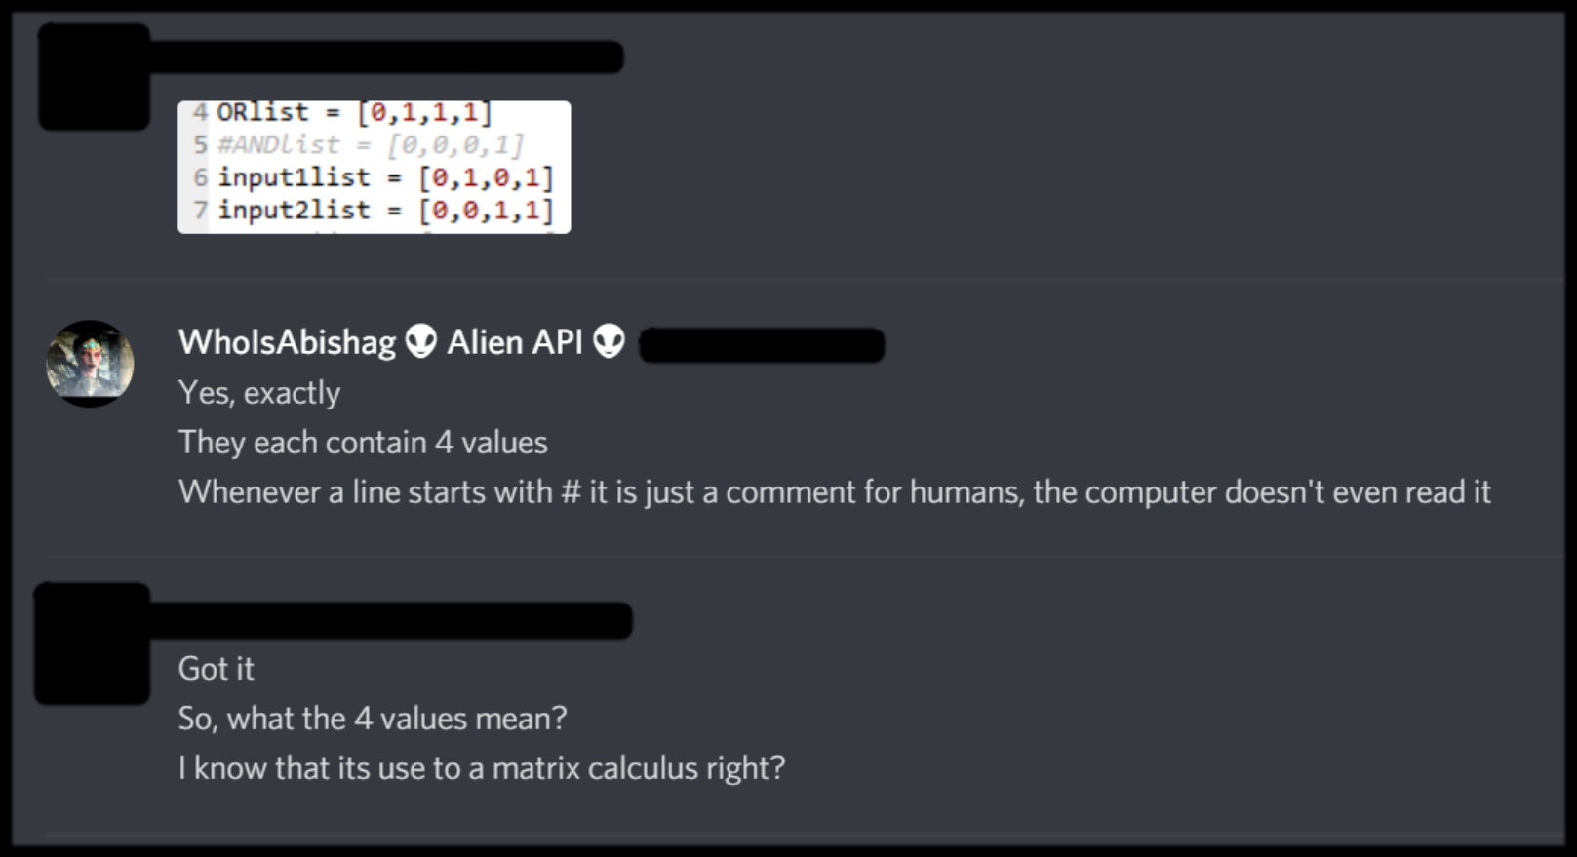
ONE Neuron Training
Some text here

Slide 9
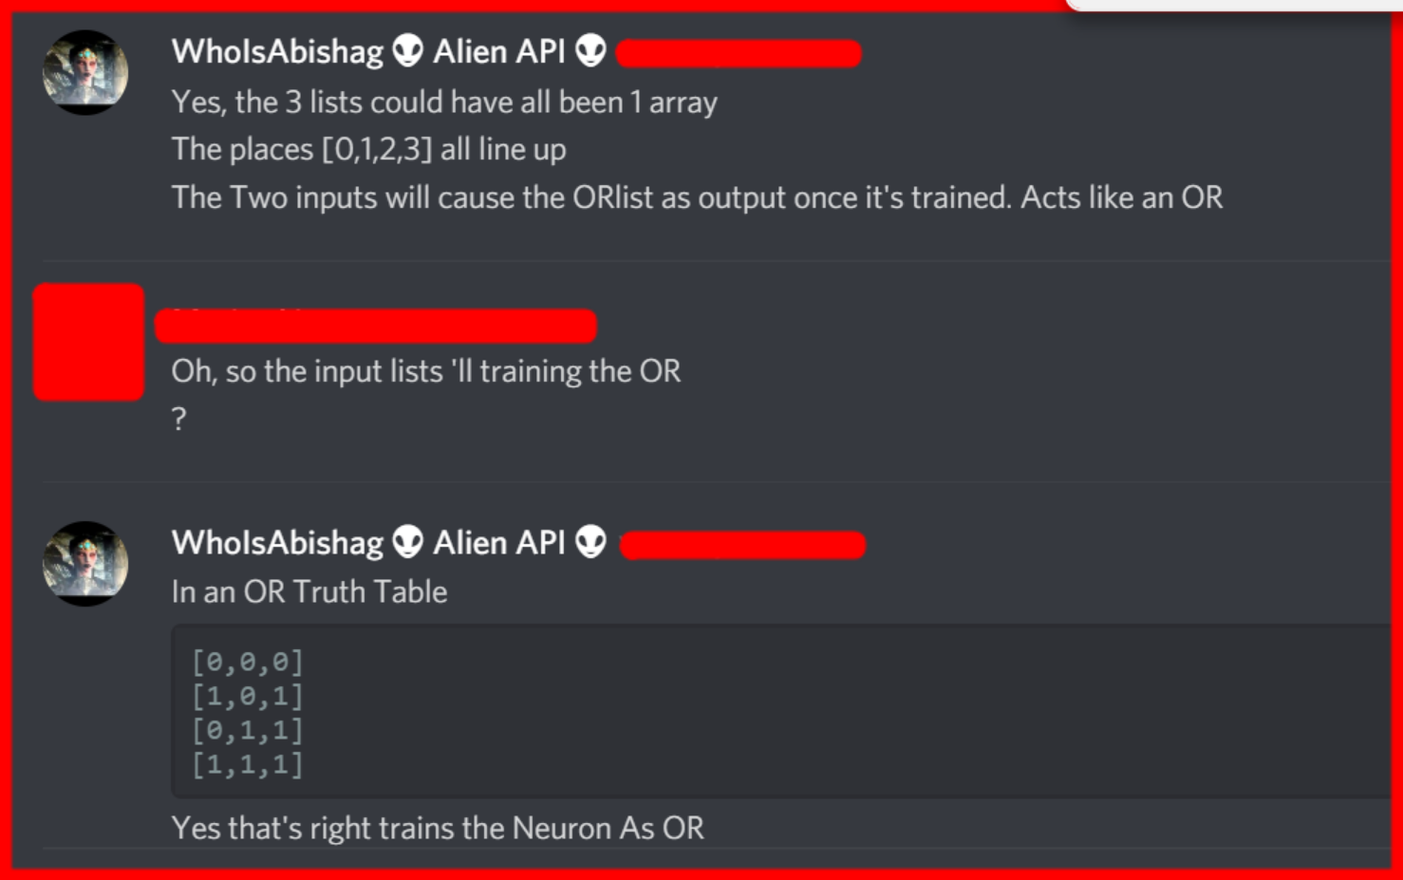
ONE Neuron Training
Some text here

Slide 10
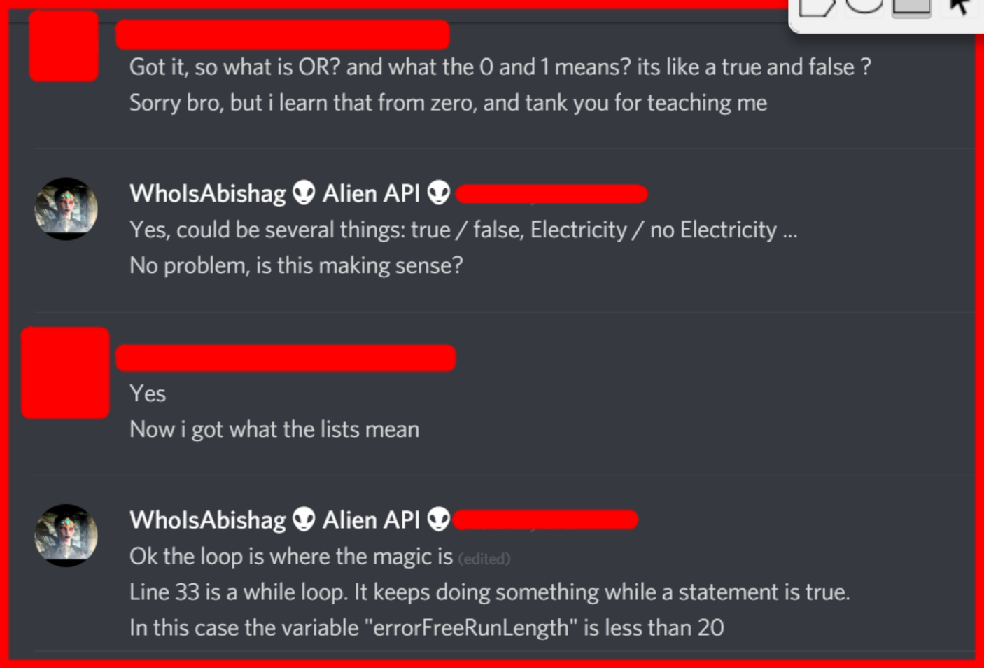
ONE Neuron Training
Some text here

Slide 11
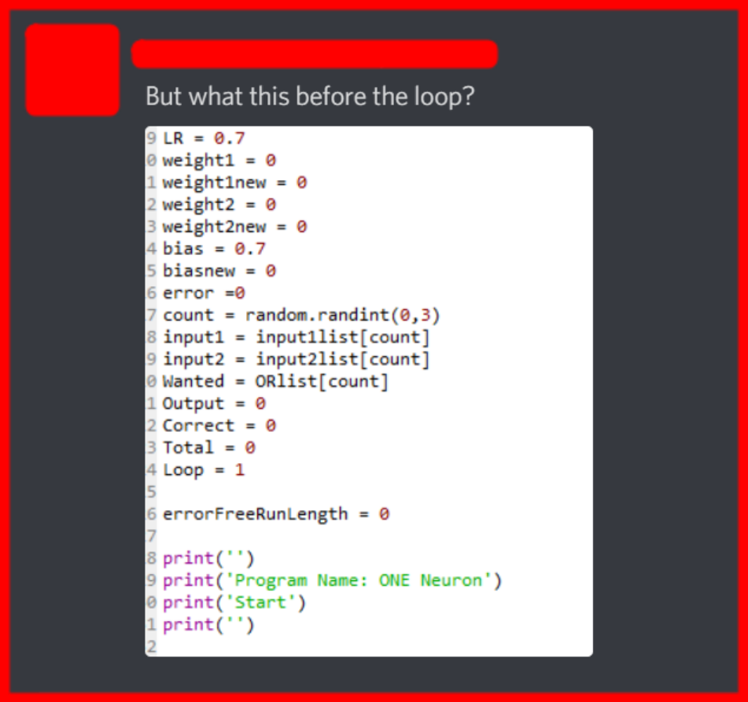
ONE Neuron Training
Some text here

Slide 12
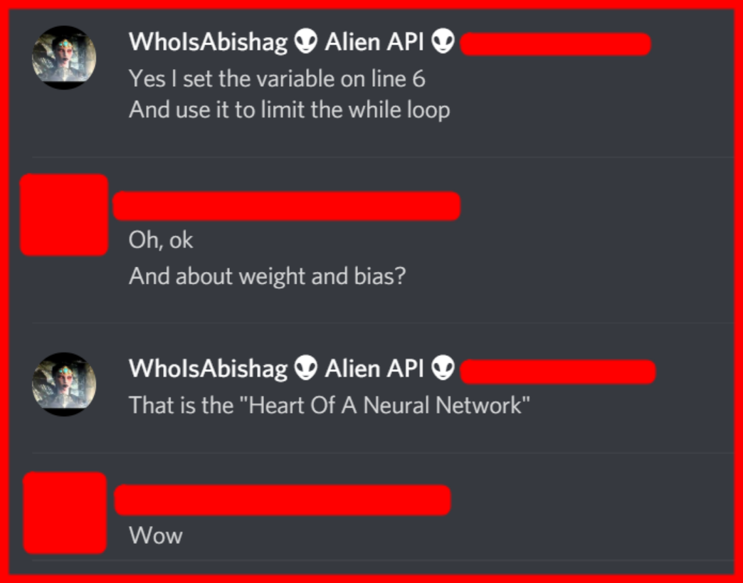
ONE Neuron Training
Some text here

Slide 13
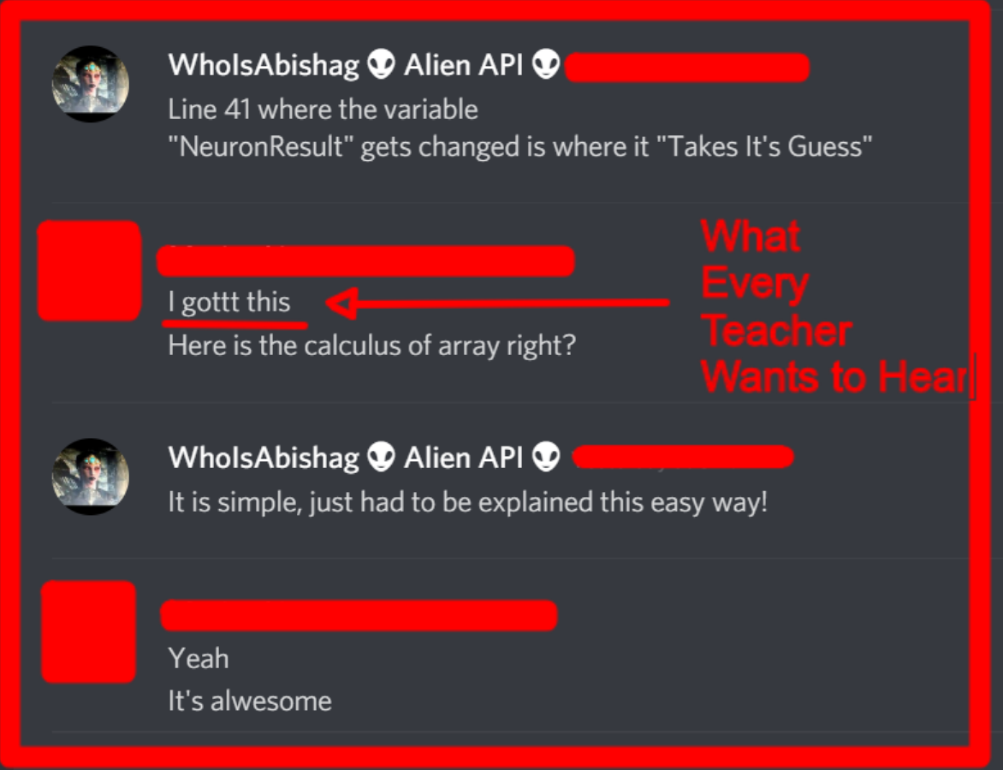
ONE Neuron Training
Some text here

Slide 14
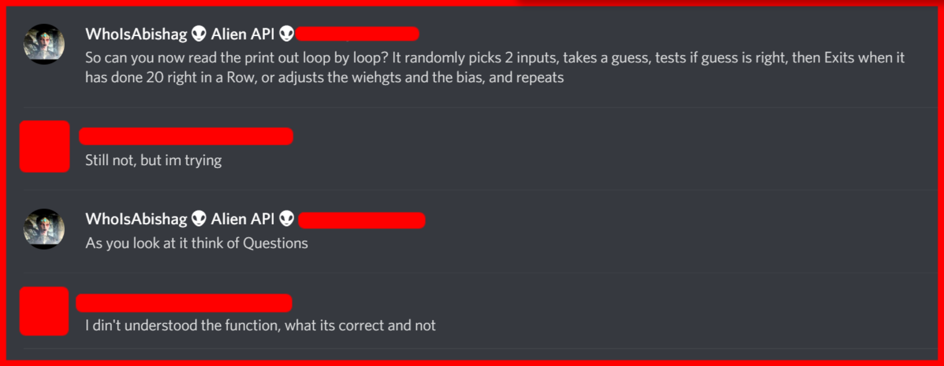
ONE Neuron Training
Some text here

Slide 15
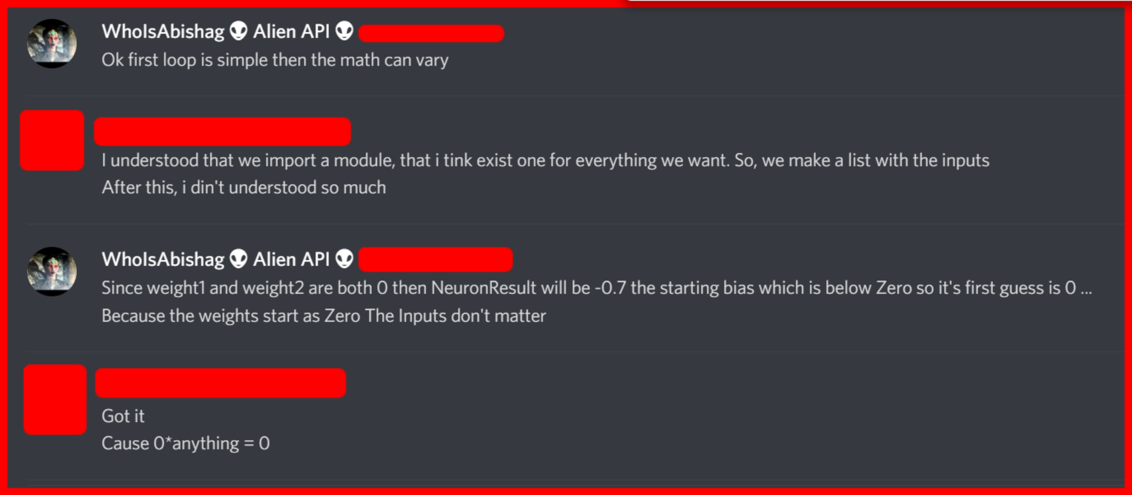
ONE Neuron Training
Some text here

Slide 16
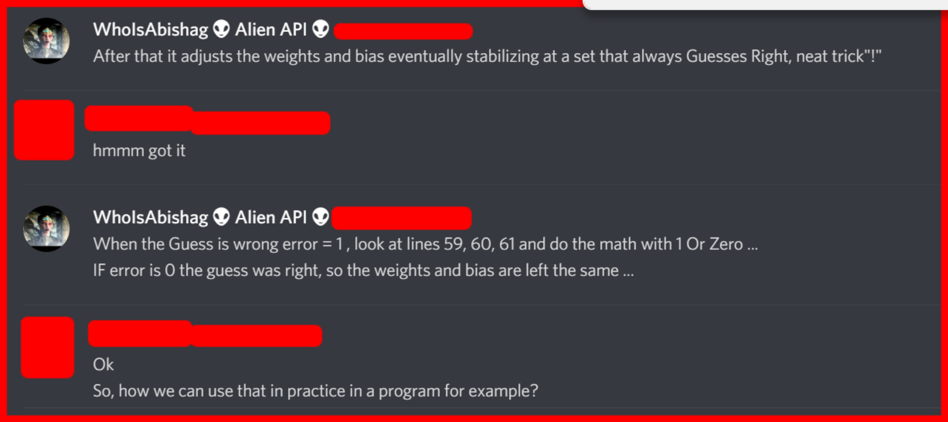
ONE Neuron Training
Some text here

Slide 17
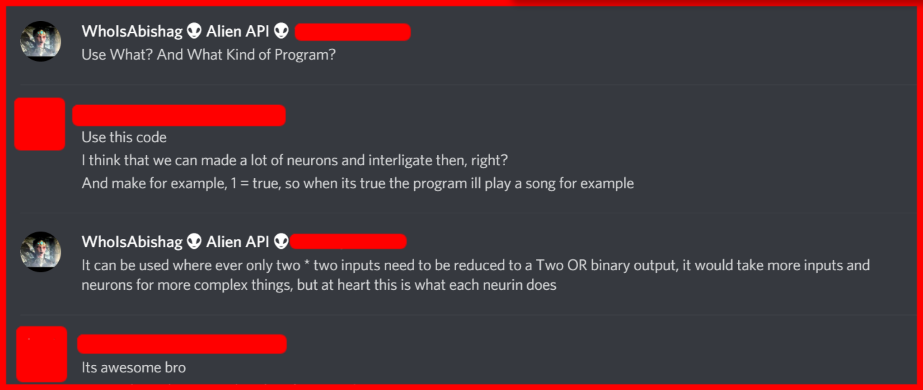
ONE Neuron Training
Some text here

Slide 18
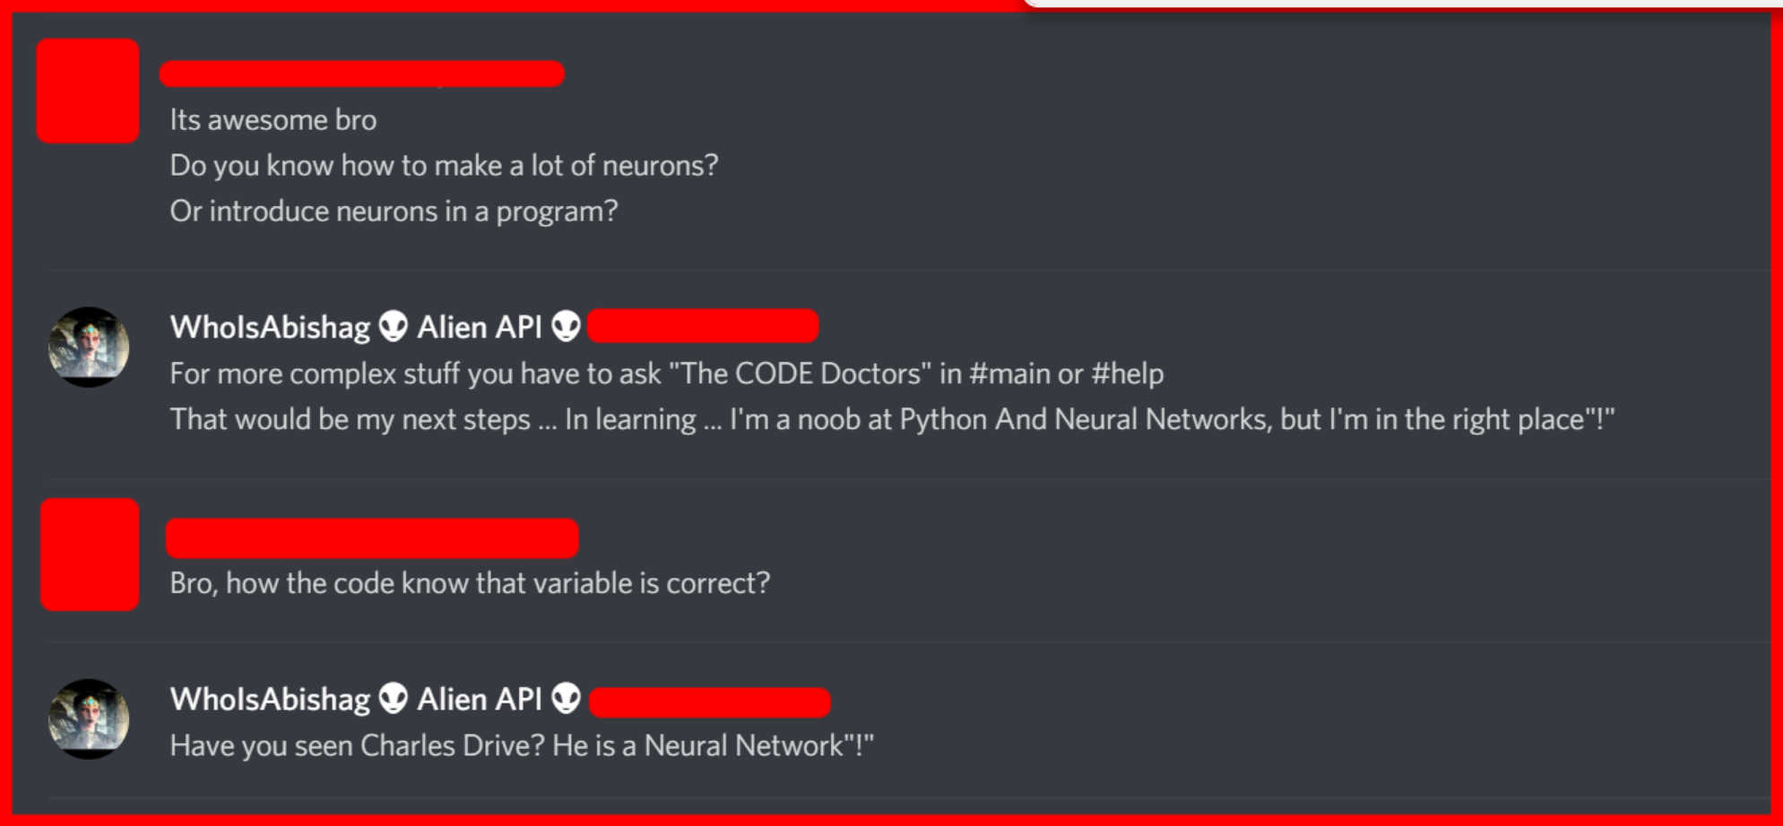
ONE Neuron Training
Some text here

Slide 19
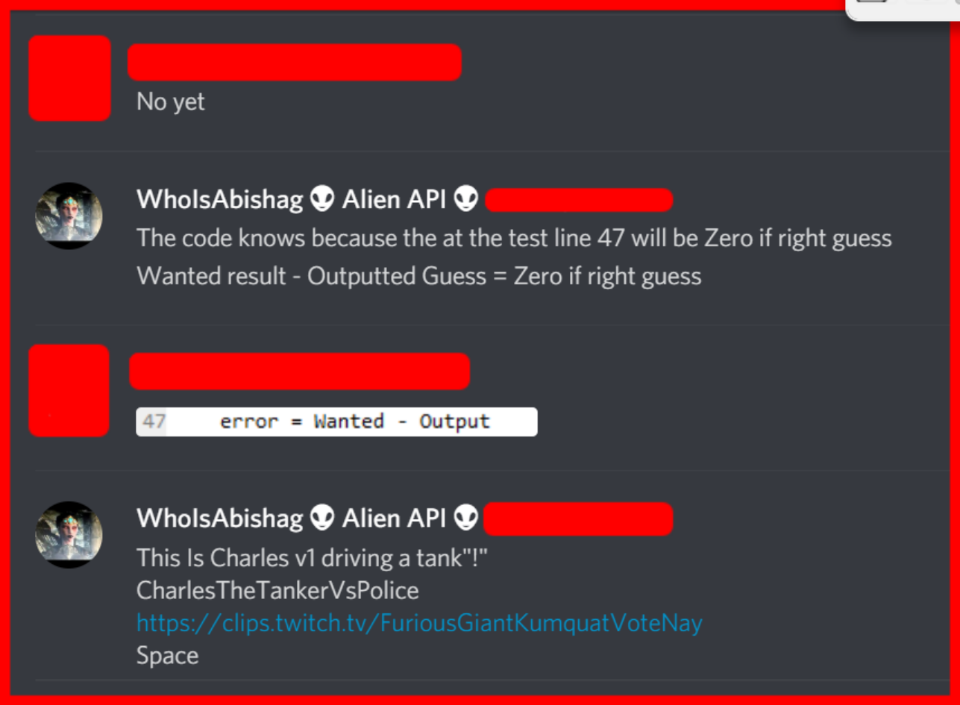
ONE Neuron Training
Some text here

Slide 20
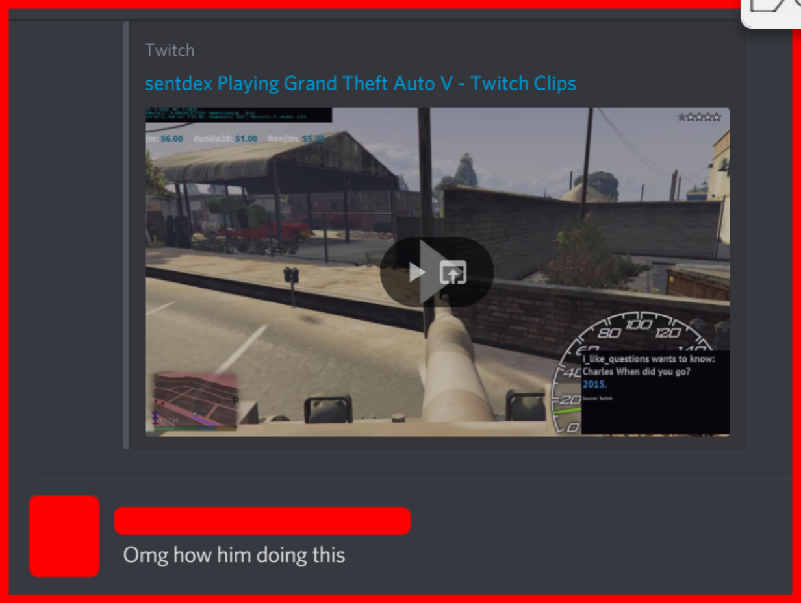
ONE Neuron Training
Some text here

Slide 21
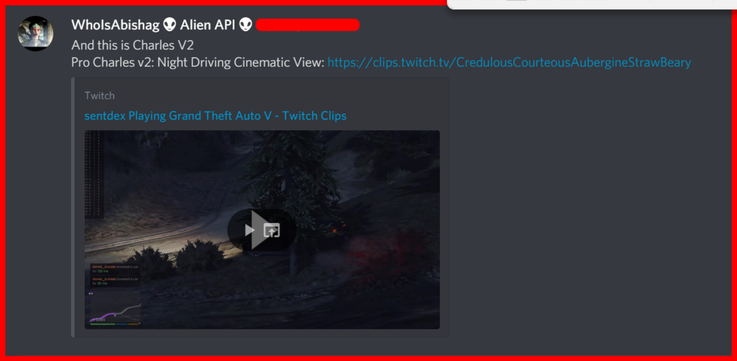
ONE Neuron Training
Some text here

Slide 22
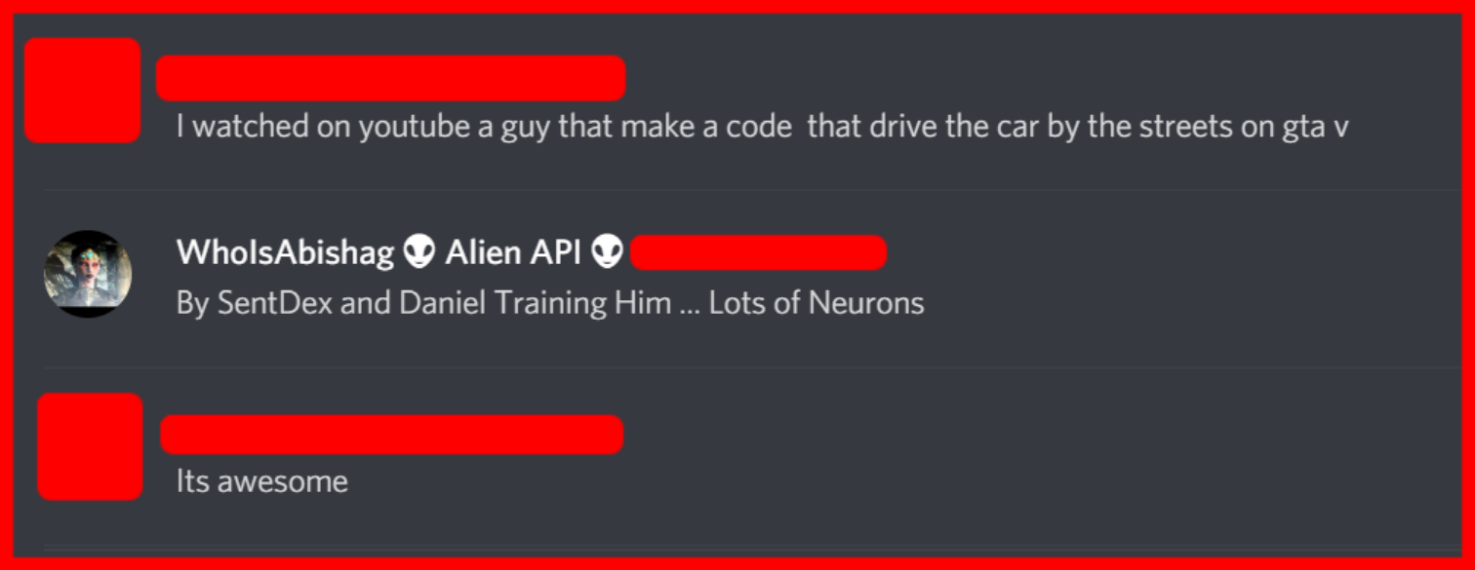
ONE Neuron Training
Some text here

Slide 23
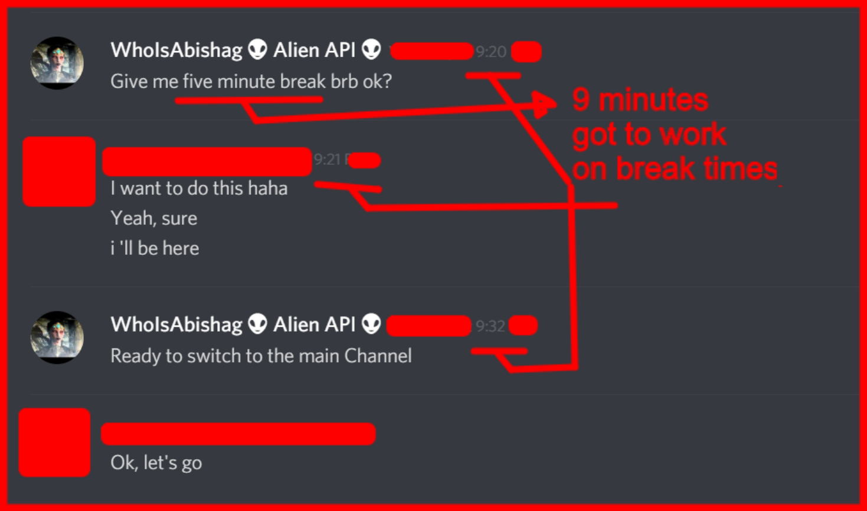
ONE Neuron Training
Some text here

